Slide 1

BioTime 7.0
Web-Based Time Attendance Software

Slide 2
BioTime 7.0
BioTime 7.0 is a powerful web-based time attendance software that can manage thousands of time attendance terminals under complex network (WLAN).
It features a simple access control module that can connect to ZKTeco standalone access control terminals. Another outstanding feature is the payroll module that calculates employees’ wages according to their workloads and can generate WPS report easily.
With its new user-friendly UI, managing timetable, shifting schedule, and generating attendance reports have become easily managed.
www.zkteco.me

Slide 3













FEATURES
Web-Based Time Attendance Software
Flexible Shift Scheduling and Auto Shift
Simple Access Control System
Employee Self-Service
Payroll Management System and WPS Report
Multiple Admin Privilege
Auto-Synchronization of Palm, Face, Finger Vein, Fingerprint, Card, and Pin Templates
Attendance Calculation and Reports
Embedded HR Integration
Real-Time Monitoring
Automatic E-mail Alerts
Multi-Languages
Multi-level Approvals
BioTime Mobile APP
www.zkteco.me

Slide 4



WEB-BASED TIME ATTENDANCE SOFTWARE
All data will automatically transferred from device to the server
Remotely manage thousands of T&A terminals under complex network condition (WLAN)
Multiple admin can access the Web-based system anywhere
Easy to set Timetable, Shift
Easy to assign schedule
Easy to generate report
www.zkteco.me

Slide 5
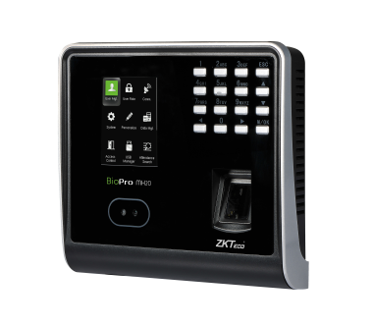
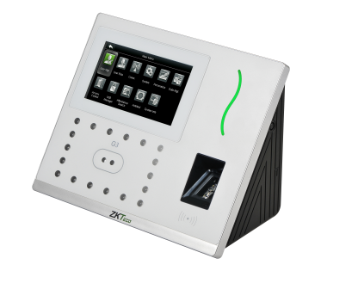
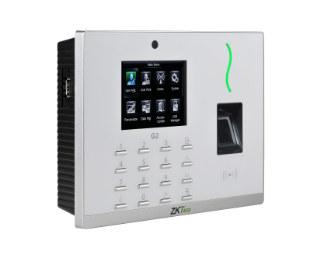
AUTO-SYNCHRONIZATION OF ATTENDANCE & DATA
“Area 1”
“Area 2”
Automatically synchronizing the data between devices and server among the same “Area” to ensure the information are updated.
www.zkteco.me

Slide 6
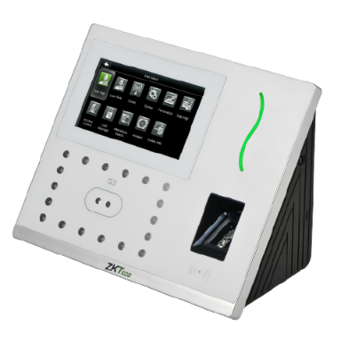
AUTO-SYNCHRONIZATION OF ATTENDANCE & DATA
“Area 1”
Device 1
Device 2
Devices and Personnel in same “Area” will keep data synchronization.
www.zkteco.me

Slide 7
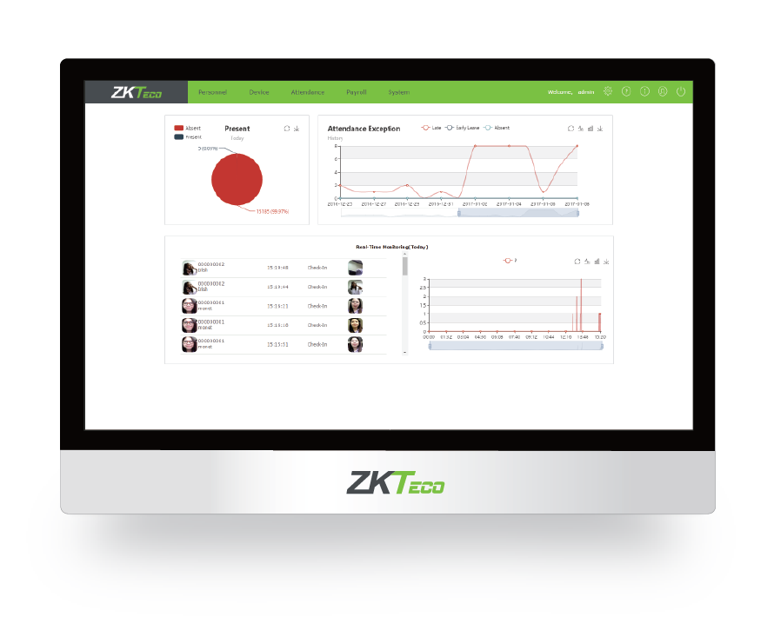
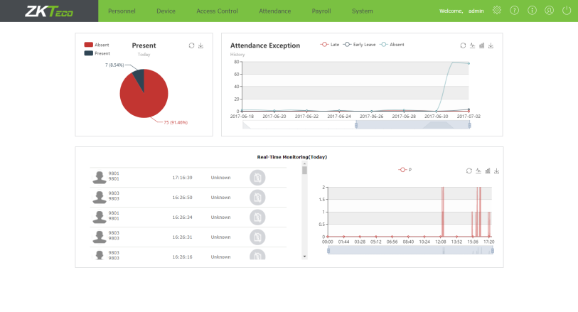
E-MAIL NOTIFICATION ALERTS
E-mail notifications are sent to employees for attendance alerts in case of late, early leave, and absence.
www.zkteco.me

Slide 8





EMPLOYEE SELF-SERVICE ENQUIRY
Employees can:
• Apply leave
• Apply manual punch
• Apply overtime
• Self Report Enquiry
www.zkteco.me

Slide 9
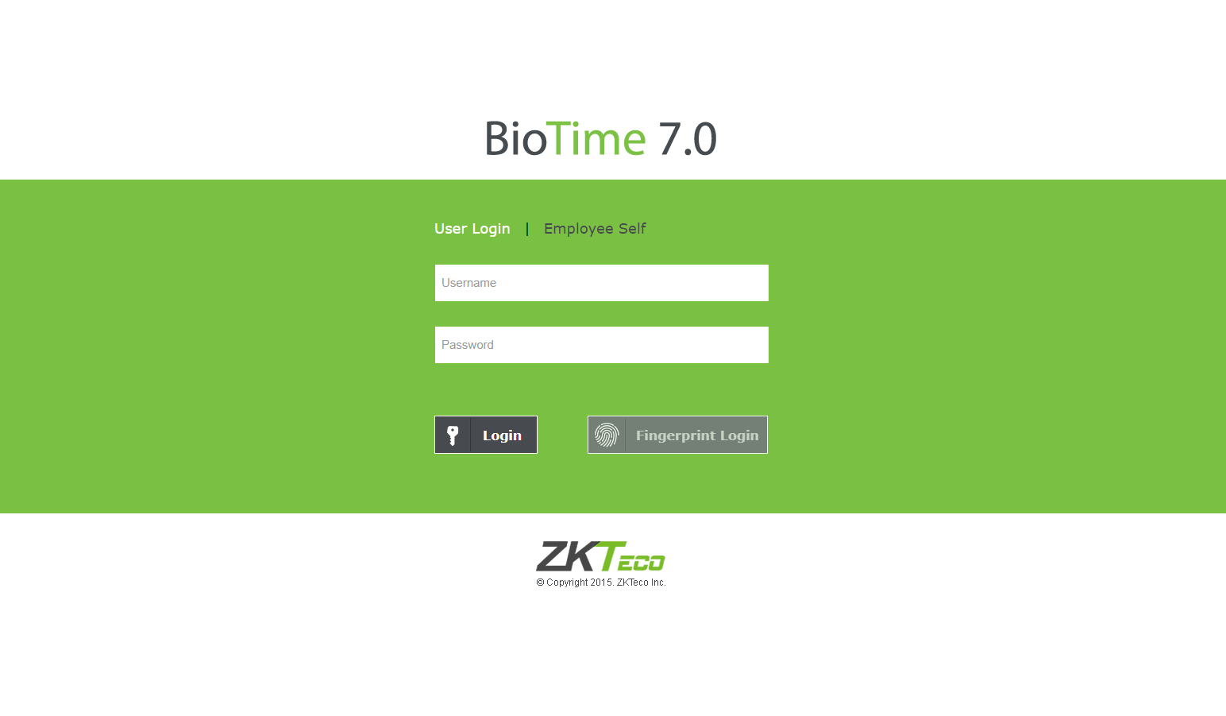
MULTIPLE ADMIN PRIVILEGE
Multiple admin can be set to manage different privilege in the software. Admin will get a list of employee’s attendance including the number of late and absences.
www.zkteco.me

Slide 10
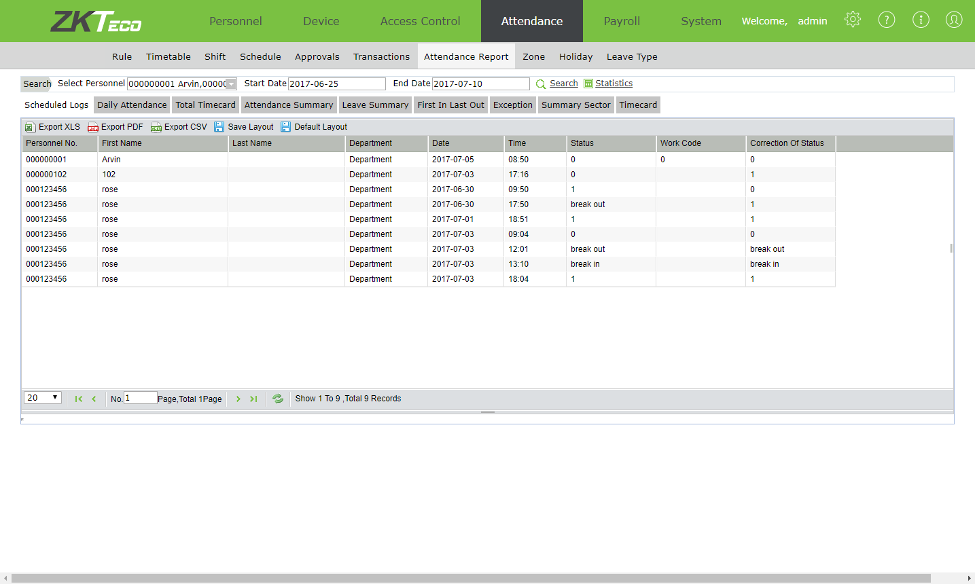
ATTENDANCE CALCULATION AND REPORTS
The attendance reports are calculated easily and can be exported in CSV, PDF, and XLS format.
www.zkteco.me

Slide 11
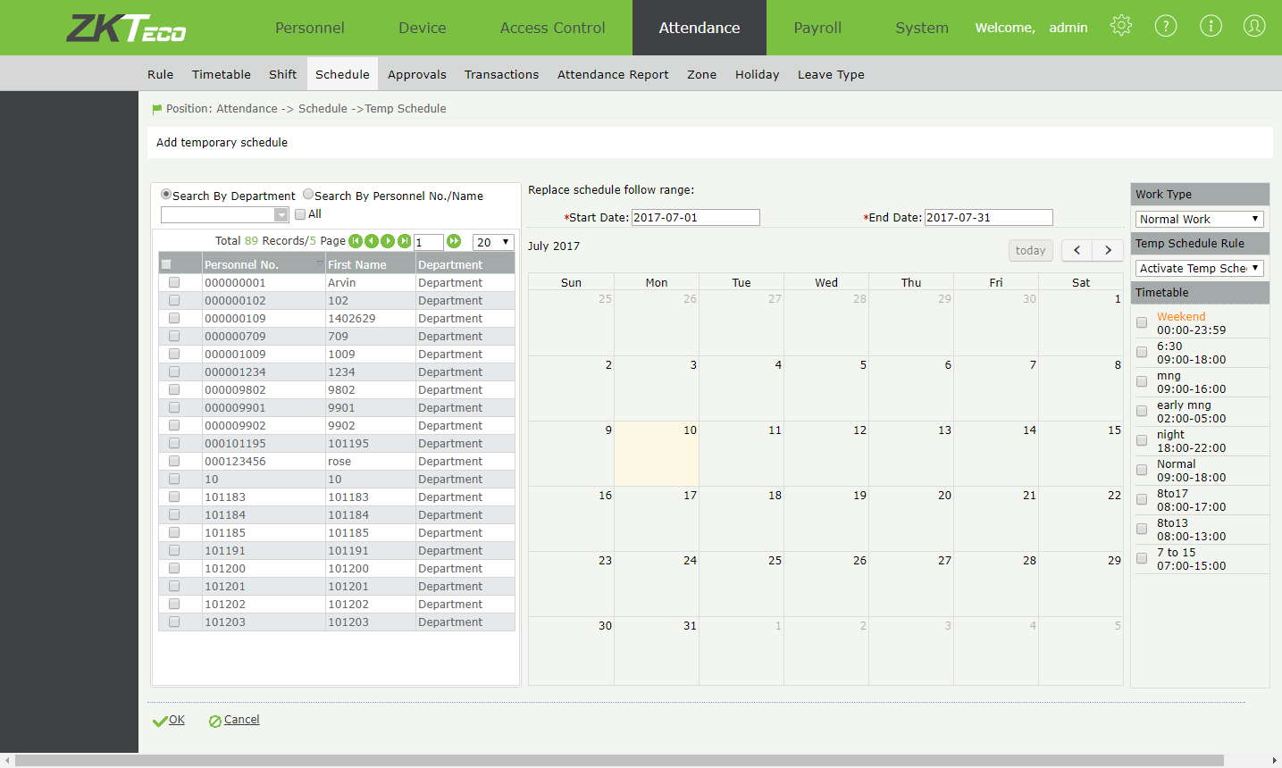
FLEXIBLE SHIFT SCHEDULING
Multiple Timetable
Cross day (24 hours) shift
Shift Cycle
Auto shift
Temporary Schedule
www.zkteco.me

Slide 12
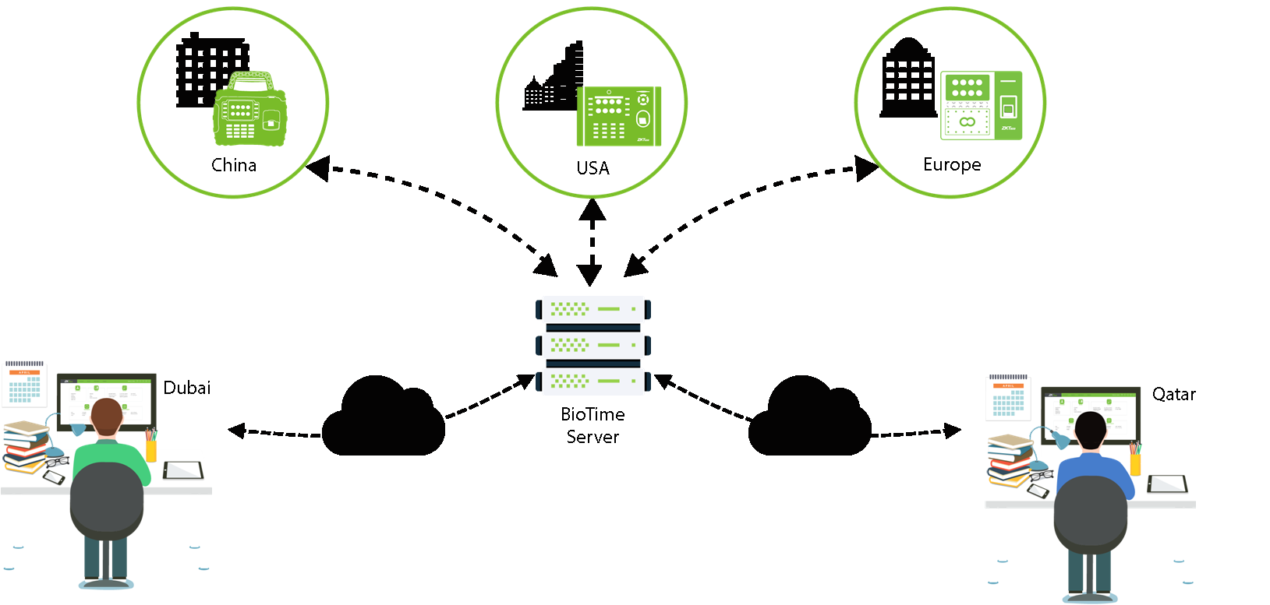
MULTI-LOCATION CENTRALIZED MANAGEMENT
www.zkteco.me

Slide 13
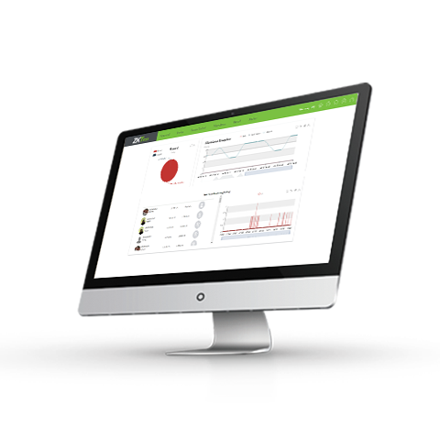
EMBEDDED HR INTEGRATION
BioTime 7.0 is a platform which can be integrated with ERP and HR software to do synchronization in these fields (Employee, Department, Area, Job) with Middle table.
www.zkteco.me

Slide 14
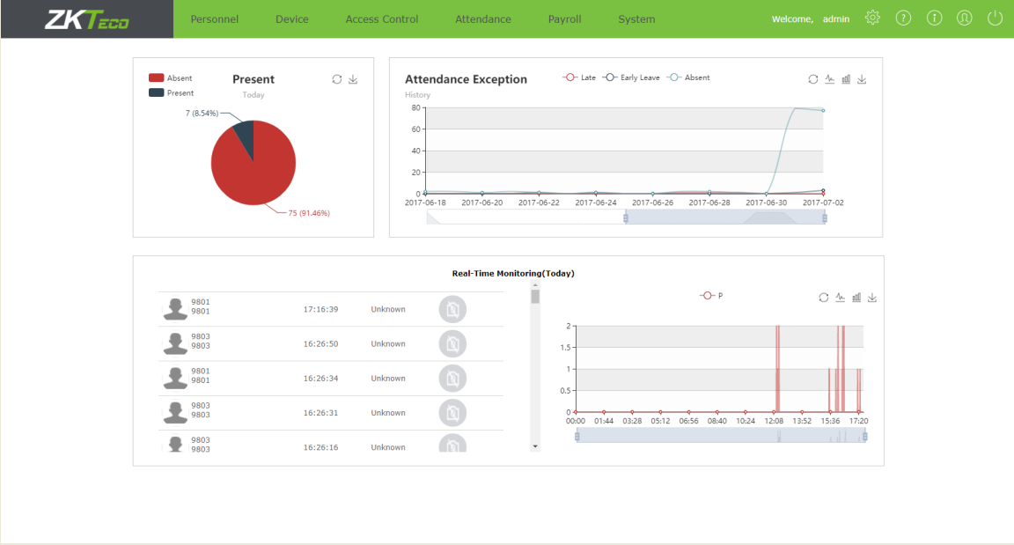
REAL-TIME DASHBOARD
Easy menu navigation
User-friendly interface
You can manage attendance, personnel, device, and payroll in one system.
www.zkteco.me

Slide 15
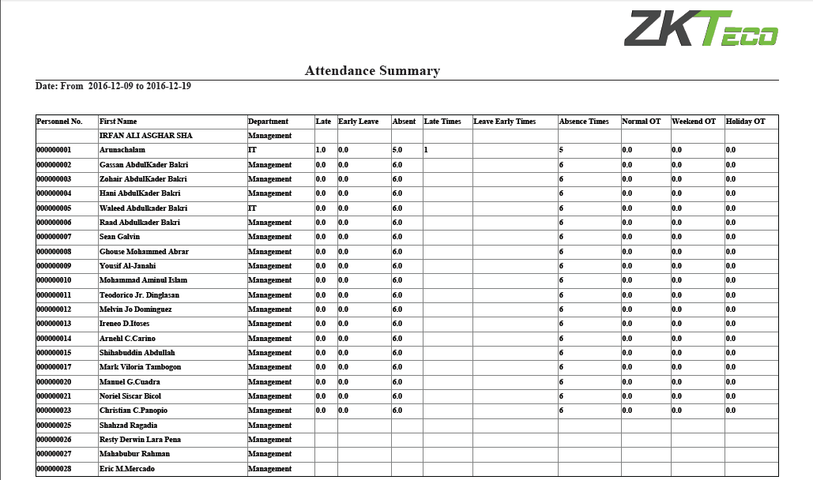
BIOTIME 7.0 SAMPLE REPORTS
Attendance Summary
www.zkteco.me

Slide 16
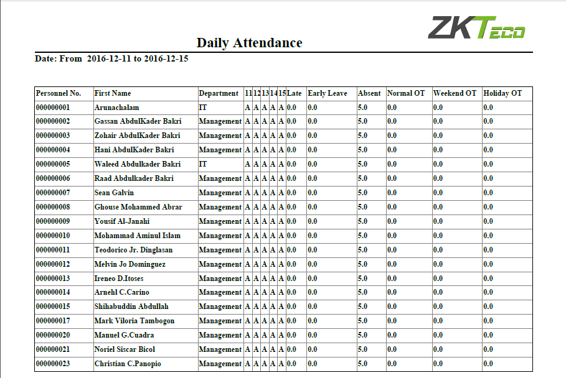
BIOTIME 7.0 SAMPLE REPORTS
Daily Attendance
www.zkteco.me

Slide 17
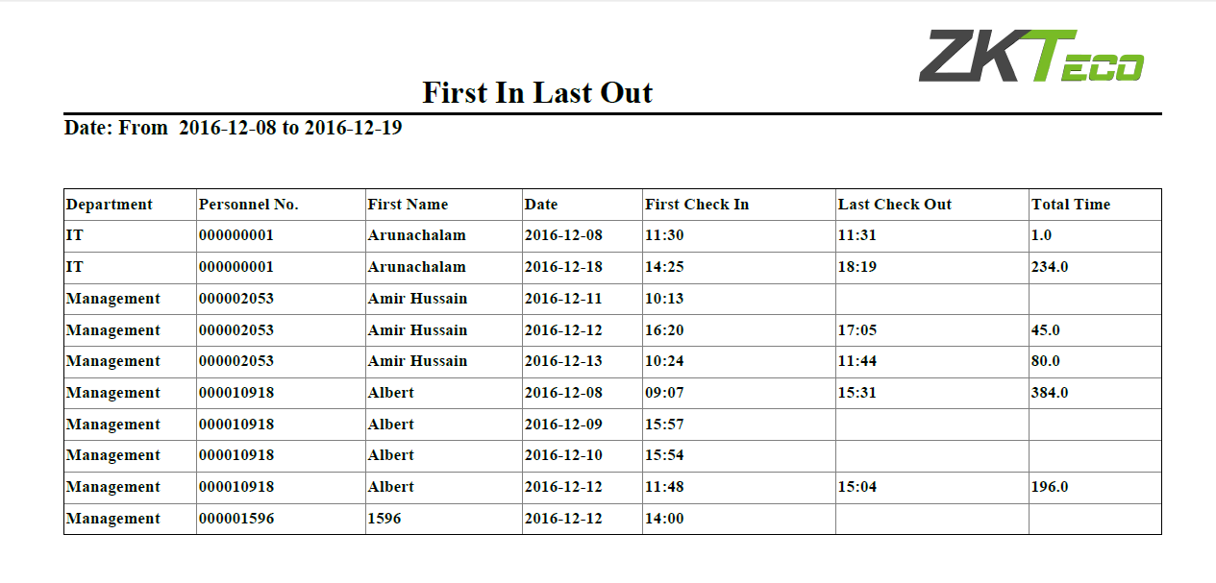
BIOTIME 7.0 SAMPLE REPORTS
First In, Last Out
www.zkteco.me

Slide 18
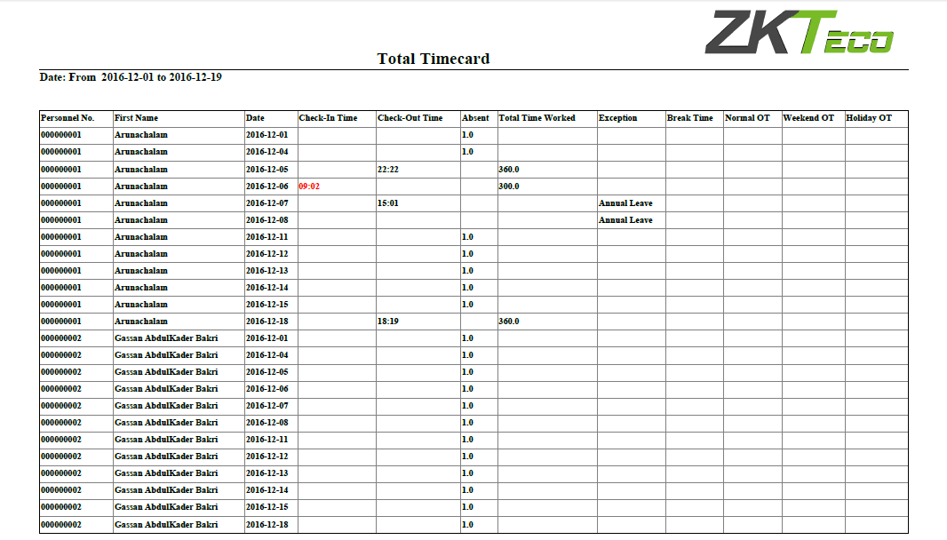
BIOTIME 7.0 SAMPLE REPORTS
Total Timecard
www.zkteco.me

Slide 19
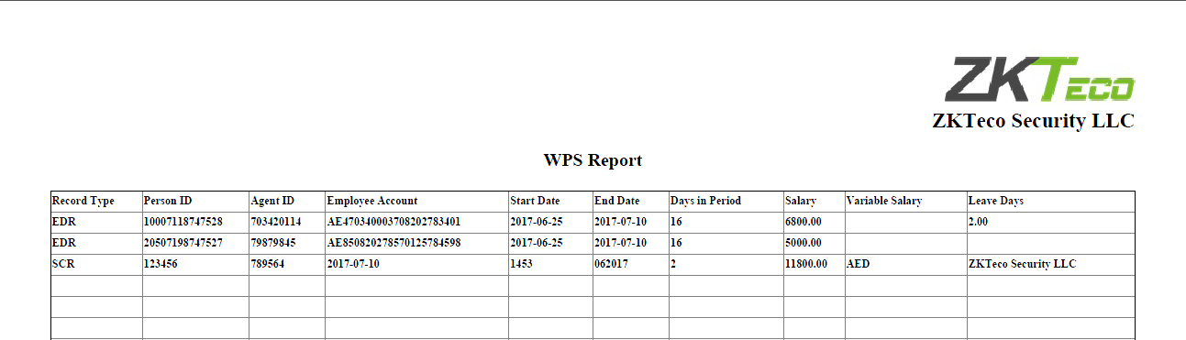
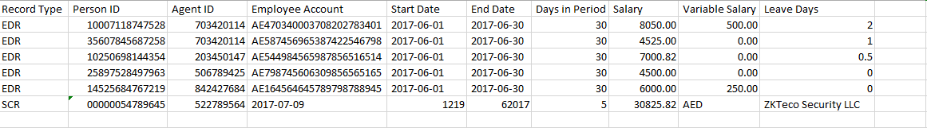
WPS REPORT CALCULATION
www.zkteco.me

Slide 20
TECHNICAL SPECIFICATION
ITEMS | SUPPORT
Templates | Palm / Finger Vein / Face / Fingerprint / RFID / Pin
Server | Windows 7 (64-bit)/8/8.1/10, Windows Server 2003/2008/2012/2014
Network | TCP/IP / Wi-Fi / GPRS / 3G
Protocol | Push SDK(Push Protocol)
Browser | IE 11+ / Firefox 27+ / Chrome 33+
Database | PostgreSQL(Default) / MS SQL Server 2005/2008 (Recommended) / MySQL / Oracle11g
www.zkteco.me

Slide 21
HARDWARE REQUIREMENT
ITEMS | SUPPORT
 | 100 Devices | 200 Devices | 500+ Devices
CPU | Intel i3 Quad Core | Intel i5 Magny-Cours | Intel i7 Magny-Cours
RAM | 4G | 8G | 16G
Storage | Available space of 100G or above. (We recommend using NTFS hard disk partition as the software installation directory)
OS | Windows 7-64 bit/ Windows 8/ Windows Server 2003/2008
Monitor Resolution | 1024*768px or above
www.zkteco.me

Slide 22
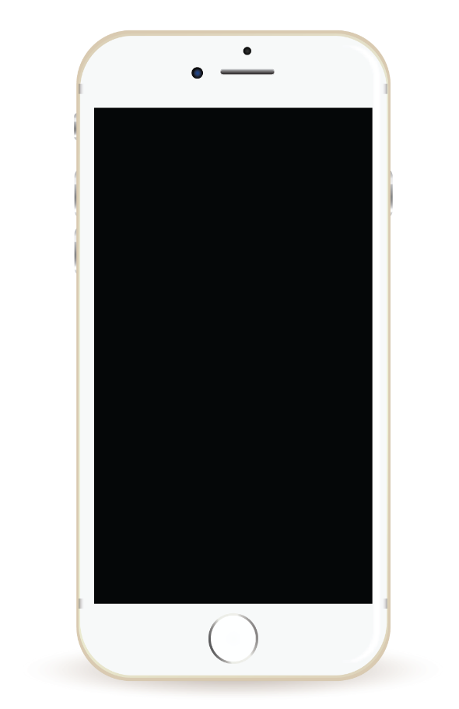
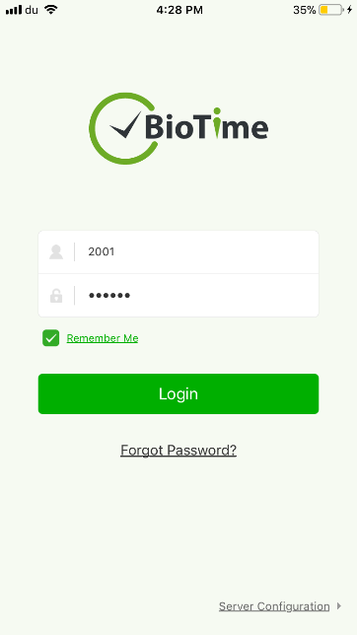
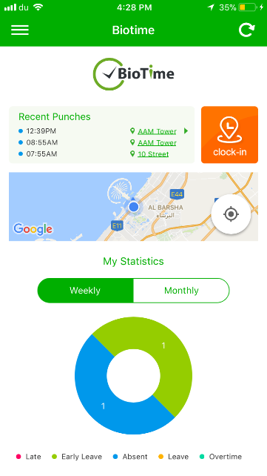
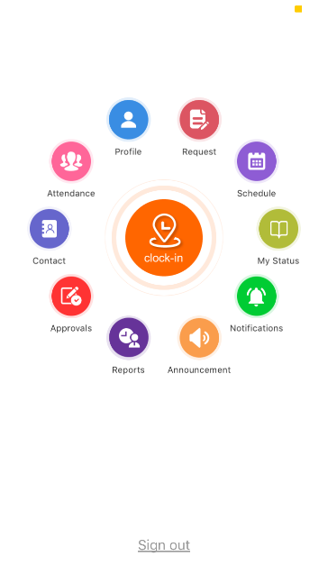
BIOTIME 7.0 MOBILE APPLICATION
Features:
Real-time attendance with geographic location details
Attendance approvals
Real time notifications
Public and Private Announcements
Easy operation: Two-step navigation
User-friendly interfaces for admin and employees
Online employee requests and status
www.zkteco.me

Slide 23
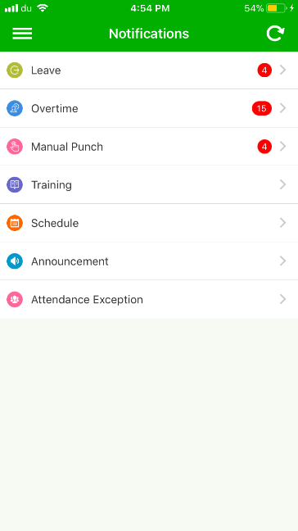
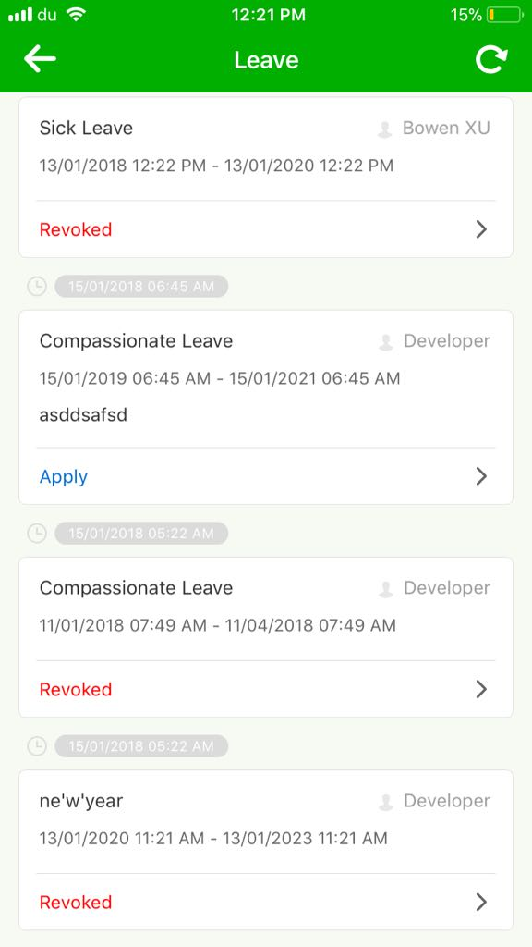
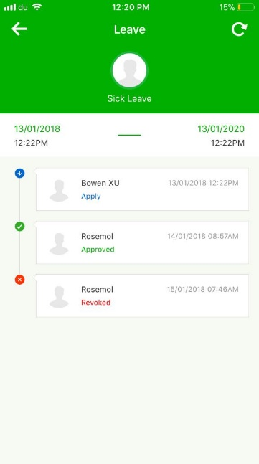
ONLINE NOTIFICATION
Interface providing easy access for employee requests.
Display the status in multilevel approvals.
www.zkteco.me

Slide 24
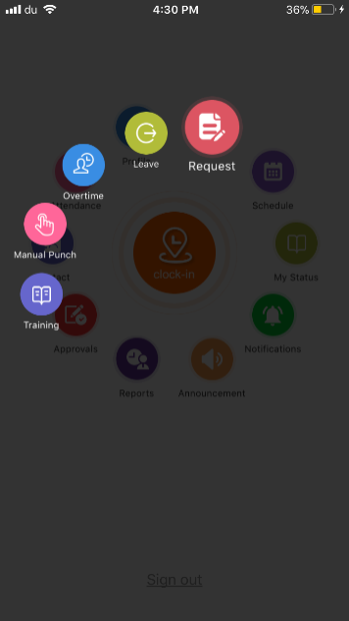
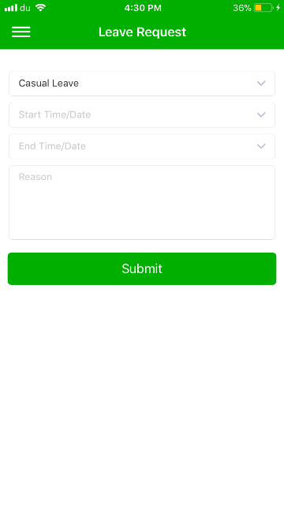
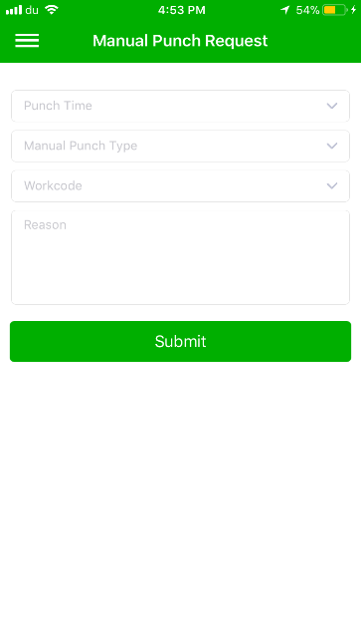
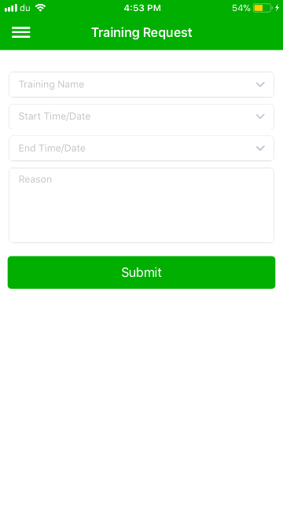
ONLINE REQUEST
My Request is to apply leave, training, overtime and manual punch.
All requests will move to approval section which are to be approved by Admin or Approver.
www.zkteco.me

Slide 25
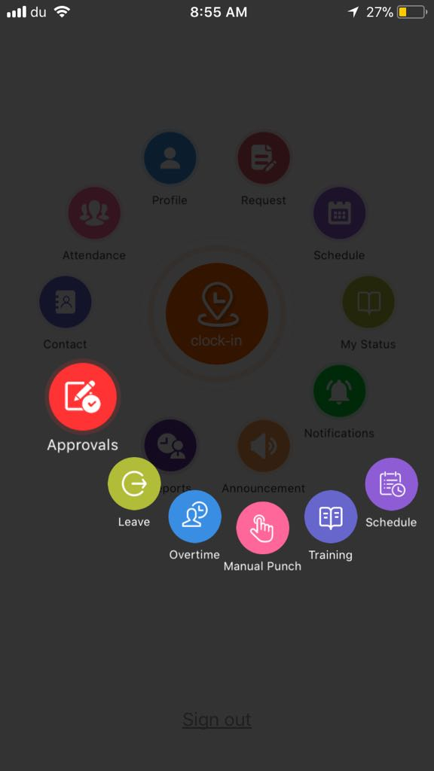
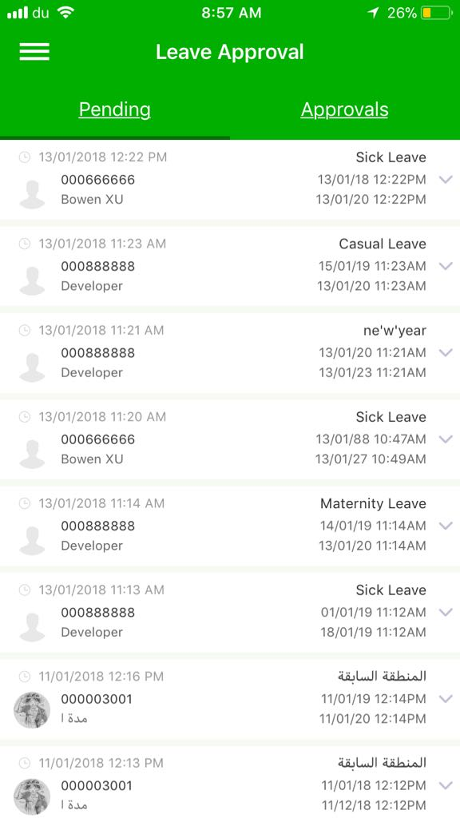
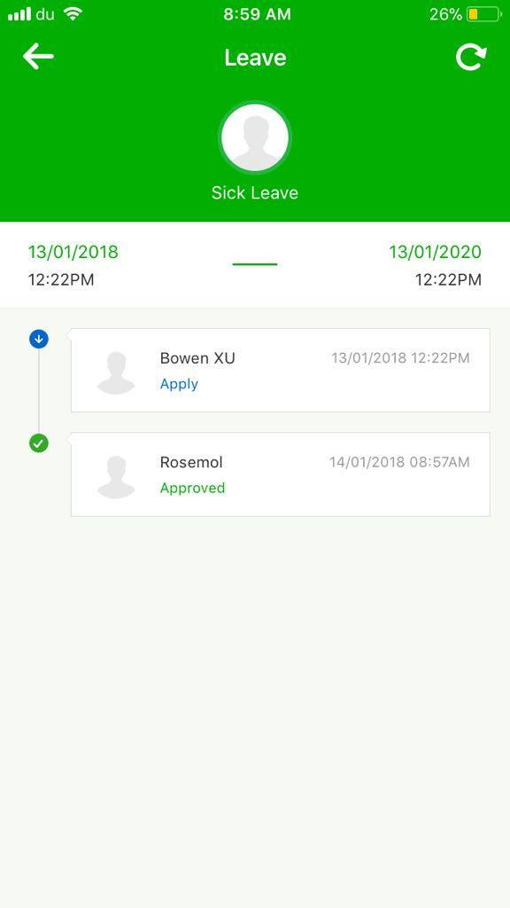
APPROVAL FLOW
Multi-level approvals for admin/approvers
Leave
Overtime
Manual Punch
Training
Schedule
www.zkteco.me

Slide 26
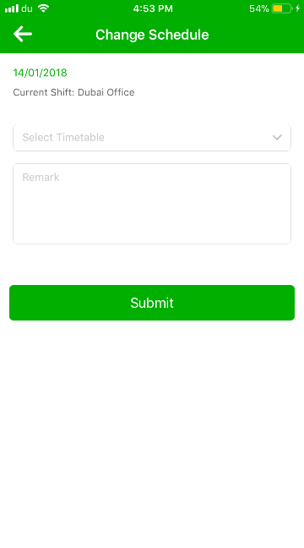
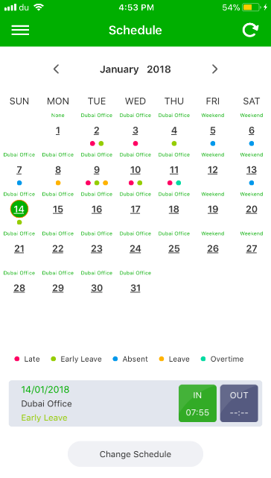
SCHEDULE ASSIGNMENT
Schedule display from BioTime main server.
Schedule change request to be approved by Admin/Approver
Online Approval for the schedule change.
www.zkteco.me

Slide 27




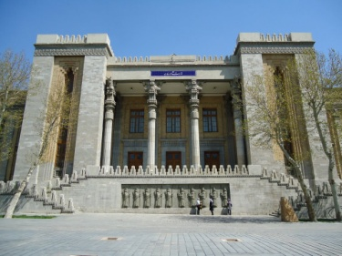






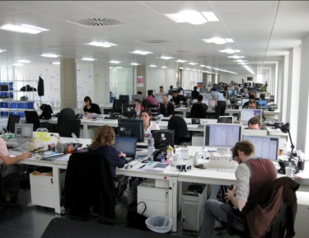

APPLICATIONS
Government
Schools & Universities
Construction Sites
Chain Stores
Hospitals
Commercial Offices
Retail & Logistics
www.zkteco.me

Slide 28




















SUCCESSFUL PROJECTS
www.zkteco.me

Slide 29
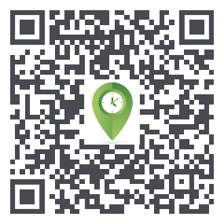
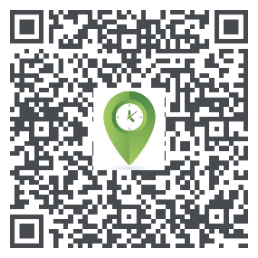
BIOTIME 7.0 TRIAL
To try the software for free: Click Here
http://80.227.52.78:8080/accounts/login/
To download the software: Click Here
Download ZKBioTime APP in App Store or Google Play Store
www.zkteco.me

Slide 30

ZKTeco Middle East
P.O. Box 4323, Office 1207, Floor 112, Arenco Tower,
Media City, Sheikh Zayed Road, Dubai, U.A.E.
E-mail: zk_me@zkteco.com
www.zkteco.me

